Slide 1
Text Mining

Slide 2
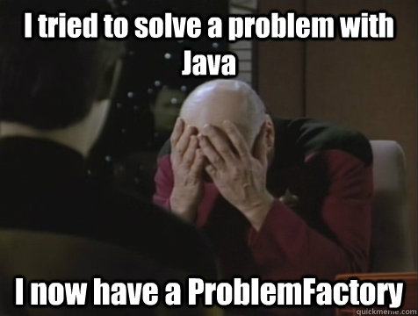
Mo’ Packages Mo’ Problems
install.packages(“qdap”)
QDAP requires JAVA…so if you don’t have Java it won’t install.
install.packages(“tidytext”)
Tidytext is a “tidyverse” package, works in tibbles and with “%>%” so it’s a bit complicated.

Slide 3
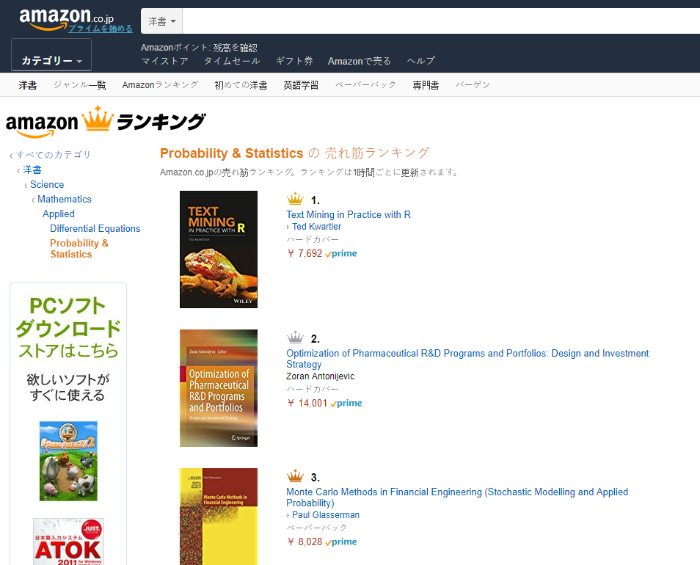

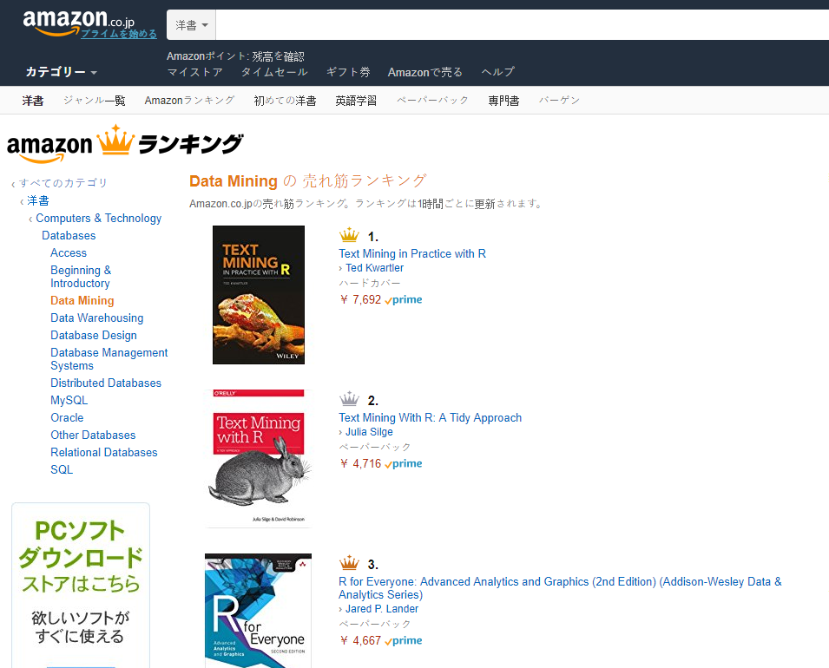
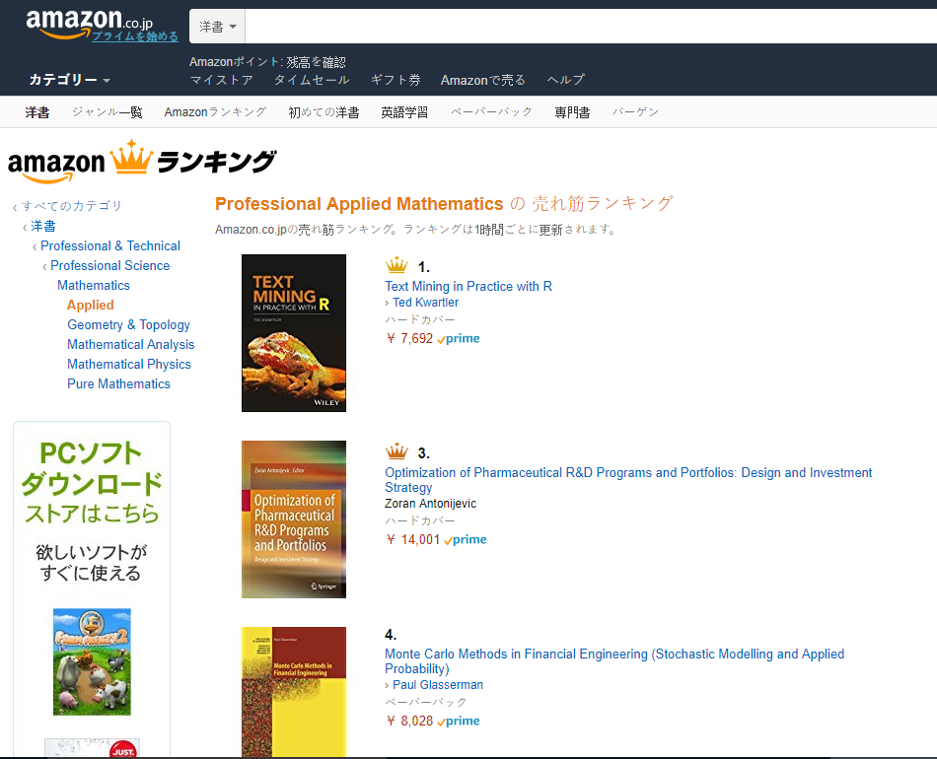
Shameless Plug #1

Slide 4


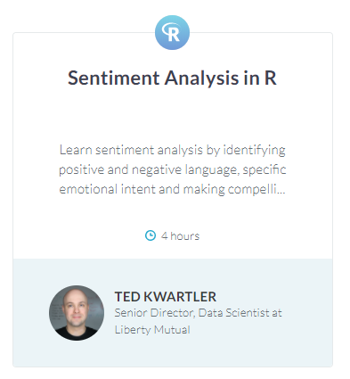
Shameless Plug #2
“Introduction to Statistics with Google Sheets”
Launching Q3

Slide 5
Agenda
Start | End | Item
 |  | What is Text Mining (TM)?
 |  | Keyword Scanning
 |  | Preparation DTM/TDM
 |  | Associations & Dendrograms (Clustering)
 |  | Simple Wordcloud
 |  | Comparison Wordcloud
 |  | Polarity/Sentiment
Goals:
Learn the basics of text mining
Apply methods to real ( & messy) data

Slide 6
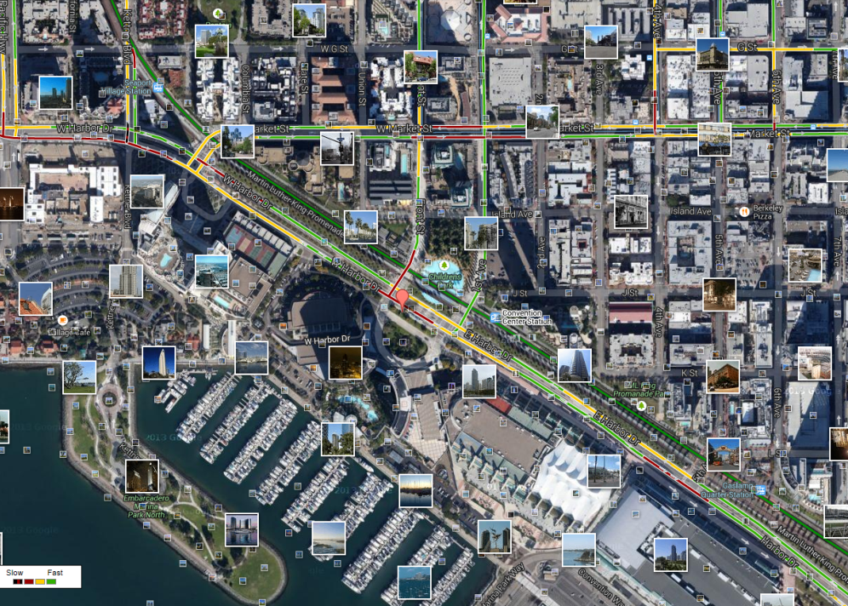
What is Text Mining?
Before Text Mining
Extract new insights from text
Let’s you drink from a fire hose of information
Language is hard; many unsolved problems
Unstructured
Expression is individualistic
Multi-language/cultural implications

Slide 7
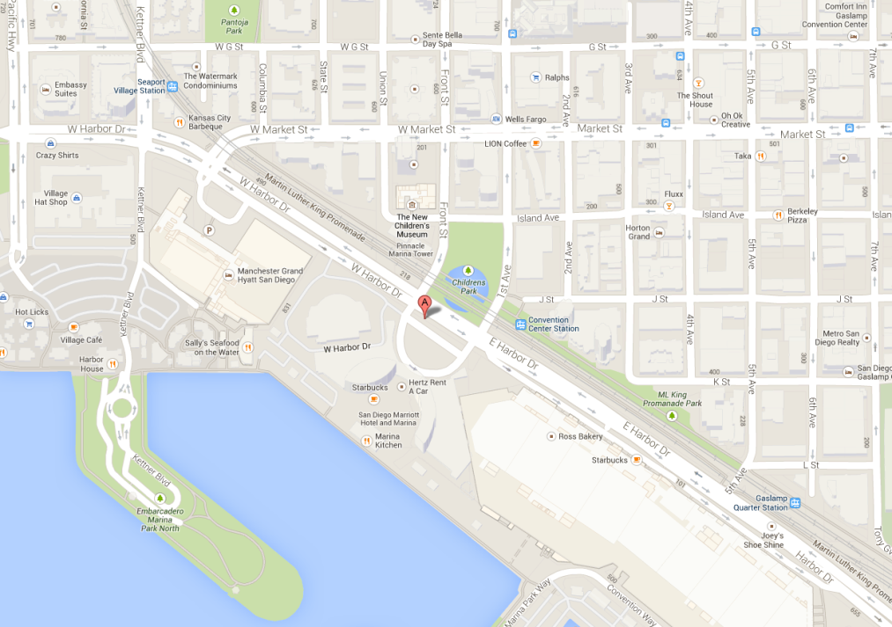
What is Text Mining?
After Text Mining
Extract new insights from text
Let’s you drink from a fire hose of information
Language is hard; many unsolved problems
Unstructured
Expression is individualistic
Multi-language/cultural implications

Slide 8
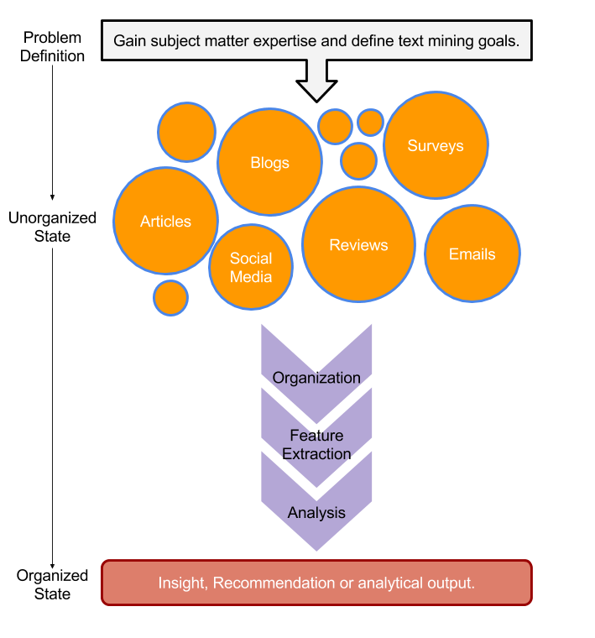
TM Project Workflow
Unorganized State
Natural Language Processing & Analysis
Organized State

Slide 9
Text Mining Workflow
Problem Definition
Identify Text Sources
Text Organization
Feature Extraction
Analytics
Reach Insight or Recommendation

Slide 10
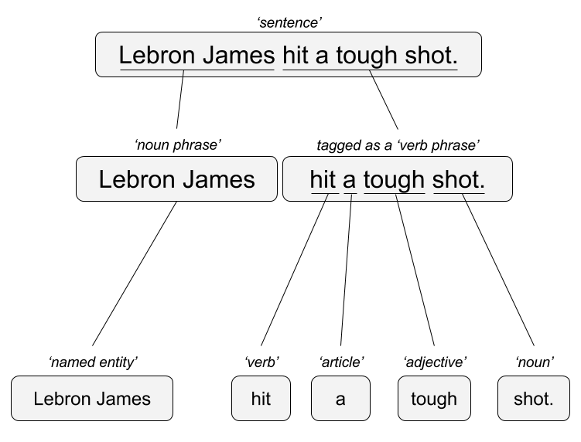

Two Popular Approaches
“Lebron James hit a tough shot.”
Syntactic Parsing
Bag of Words
Lebron
a
James
hit
tough
shot
*There are other approaches usually based on DNN, that I refer to “abstractive”

Slide 11

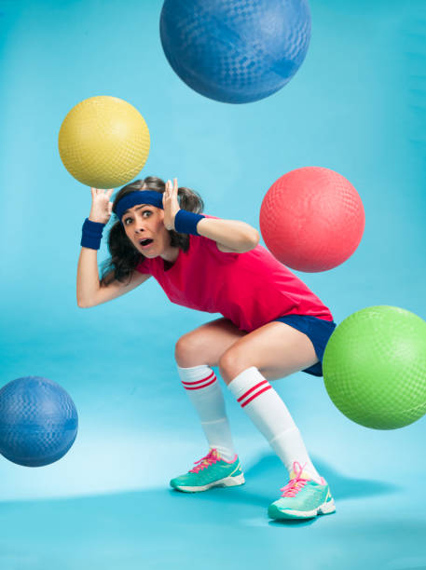
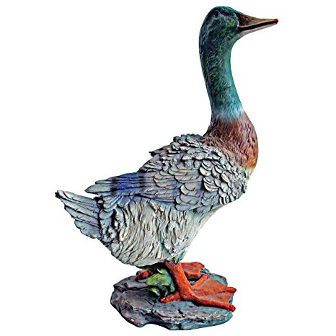
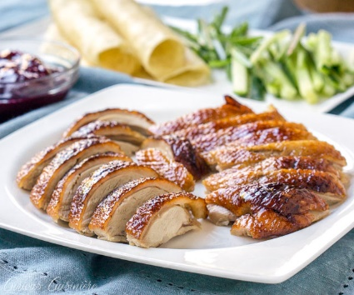
TM Challenges - Disambiguation
I made her duck.
I cooked waterfowl for her to eat.
I cooked waterfowl belonging to her.
I created the (clay?) duck and gave it to her.
Duck!!

Slide 12
TM Challenges - Misc
Other Challenges
Examples
Compound words (tokenization) change meaning
Sarcasm
Cultural differences
“Bad” vs “not bad”
“I like it…NOT!”
“It’s wicked good” (in Boston)

Slide 13





Why text mining is an art & science?
Challenges because human expression is diverse, often ambiguous, affected by age, demographics, socio-economics, medium/channel & regional attributes of the author.
Common Sources
Source & context are important, directly impacting data integrity.
Books
Electronic Docs (PDFs)
Blogs
Websites
Social Media
Customer Records
Customer Service Notes
Notes
Emails
Legal Documents
…

Slide 14



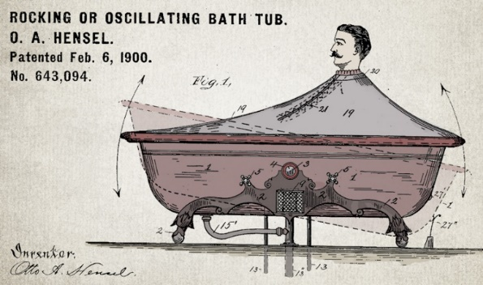

Channel affects language
🐝🔀🙏👁️👁️➡️🌎
Legal documents are verbose & technical.
“Be the change you want to see in the world.”
“kappa” indicates sarcasm, irony,
or a joke among online gamers.
Expression is context specific making analysis challenging.

Slide 15



Messenger affects language
Boomers 1946-1964
* Make a difference * Consensus/team * Experiment/try new things * “Imagine if…” * Save time * Features and benefits
Gen X 1965-1980
Best, finest, world-class
“You will benefit by…”
”This is in your best interest.”
Gen Y 1981-2000
Global citizen
Balance
Diversity
Community/connections
Beyond generation, other factors like socio-economic, gender & demographic makeup impact expression.
https://www.anneloehr.com/

Slide 16


Gen Y/Z expression is evolving rapidly due to technology.
“Thank you, next.”
“Woke”
“Cray”
“Gucci”
“Squad goal”
“Bible…”
“Adulting”
“Turnt”
“Hundo P”
“Trill”
“TFW”
Beyond generation, other factors like socio-economic, gender & demographic makeup impact expression.

Slide 17
Gen Y/Z expression is evolving rapidly due to technology.
“Thank you, next.” – moving on with positive connotation
“Woke” - The more woke one is, the more sympathetic & knowledgeable one is about a topic or type of person
“Cray” - crazy
“Gucci” – fine, good
“Squad goal” – friend group behavior
“Bible…” - what follows is TRUTH
“Adulting” – activities associated with growing up
“Turnt” – “turned up” i.e. really excited
“Hundo P” – agree “100%”
“Trill” – True & Real
“TFW” – “That Feeling When” to describe an emotion
Beyond generation, other factors like socio-economic, gender & demographic makeup impact expression.

Slide 18

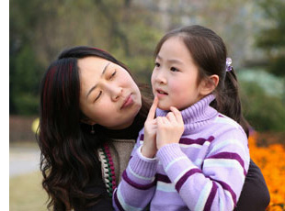
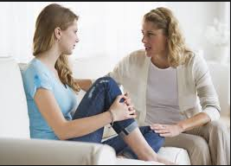

Audience affects language
And we all context switch based on who were are speaking too.

Slide 19
Agenda
Start | End | Item
 |  | What is Text Mining (TM)?
 |  | Keyword Scanning
 |  | Preparation DTM/TDM
 |  | Associations & Dendrograms (Clustering)
 |  | Simple Wordcloud
 |  | Comparison Wordcloud
 |  | Polarity/Sentiment
Goals:
Learn the basics of text mining
Apply methods to real ( & messy) data

Slide 20

Warning: Twitter Profanity
Twitter demographics skew young and as a result have profanity that appear in the examples. “Keyboard Courage” is rampant.
It’s the easiest place to get a lot of messy text fast, if it is offensive feel free to talk to me and I will work to get you other texts for use on your own. No offense is intended.
#%@*!!!

Slide 21
1_Keyword_Scanning.R
Basic R Unix Commands
Setup
grepl returns a vector of T/F if the pattern is present at least once
grepl(“pattern”, searchable object, ignore.case=TRUE)
grep returns the position of the pattern in the document
grep(“pattern”, searchable object, ignore.case=TRUE)
“library(stringi)” Functions
stri_count counts the number of patterns in a document
stri_count(searchable object, fixed=“pattern”)

Slide 22
Let’s Practice!
Open 1_Keyword_Scanning_revised.R

Slide 23
Remember This?

Slide 24

R for Cleaning Steps
Tomorrow I’m going to have a nice glass of Chardonnay and wind down with a good book in the corner of the county :-)
Remove Punctuation
Remove extra white space
Remove Numbers
Make Lower Case
Remove “stop” words
blogs
reviews
articles
tomorrow going nice glass chardonnay wind down good book corner county

Slide 25
Library TM Functions
VCorpus creates a corpus held in memory.
VCorpus(source)
tm_map applies the transformations for the cleaning
tm_map(corpus, function)
getTransformations() will list all standard tm corpus transformations. We can apply string functions from other packages with content_transformer(FUNCTION)
tm_map(corpus, removePunctuation) - removes punctuation from the documents
tm_map(corpus, stripWhitespace) - extra spaces, tabs are removed
tm_map(corpus, removeNumbers) - removes numbers
tm_map(corpus, content_transformer(tolower)) – makes all case lower
tm_map(corpus, removeWords) - removes specific “stopwords”
New Text Mining Concepts
Corpus- A collection of documents that analysis will be based on.
Stopwords – are common words that provide very little insight, often articles like “a”, “the”. Customizing them is sometimes key in order to extract valuable insights.
4/17/2019
Kwartler CSCI -96
25

Slide 26
Library qdap Functions
Multiple Global Substitutions
mgsub(“search pattern”, “replacement pattern”, text object)
Family of Replace Functions
replace_abbreviation()- Replace Abbreviations
replace_contraction()- Replace Contractions
replace_number()- Replace Numbers With Text Representation
replace_ordinal()- Replace Mixed Ordinal Numbers With Text Representation
replace_symbol()- Replace Symbols with Word Equivalents
To use on a corpus you need to apply content_transformer
tm_map(corpus, content_transformer(replace_abbreviation))
New Text Mining Concepts
Lemmatization in linguistics, is the process of grouping together the different inflected forms of a word so they can be analyzed as a single item.
4/17/2019
Kwartler CSCI -96
26

Slide 27
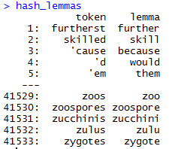
Poor Man’s Lemmatization
library(lexicon)
Qdap’s mgsub function can help you lemmatize words.
Bring in a lemmatization lexicon.
Supply a vector of patterns to search for
Supply a vector of patters to replace or change into.
Specify the vector the lexicon and substitutions should be applied to.
# Poor Man's Lemmatization
library(lexicon)
library(qdap)
data(hash_lemmas)
text$text <- mgsub(hash_lemmas$token,hash_lemmas$lemma,text$text)
Warning,: Not done in class because it takes a long time.

Slide 28
Custom Functions in 2_Cleaning_and_Frequency_Count.R
“tryTolower” is poached to account for errors when making lowercase.
tryTolower <- function(x){
# return NA when there is an error
y = NA
# tryCatch error
try_error = tryCatch(tolower(x), error = function(e) e)
# if not an error
if (!inherits(try_error, 'error'))
y = tolower(x)
return(y)}
“clean.corpus” makes applying all transformations easier.
Base: tolower (basic)
Stringr: str_to_lower (wrapper)
Custom: tryTolower (handles errors)
cleanCorpus<-function(corpus){
corpus <- tm_map(corpus, content_transformer(qdapRegex::rm_url))
corpus <- tm_map(corpus, removePunctuation)
corpus <- tm_map(corpus, stripWhitespace)
corpus <- tm_map(corpus, removeNumbers)
corpus <- tm_map(corpus, content_transformer(tryTolower))
corpus <- tm_map(corpus, removeWords, customStopwords)
return(corpus)
}

Slide 29
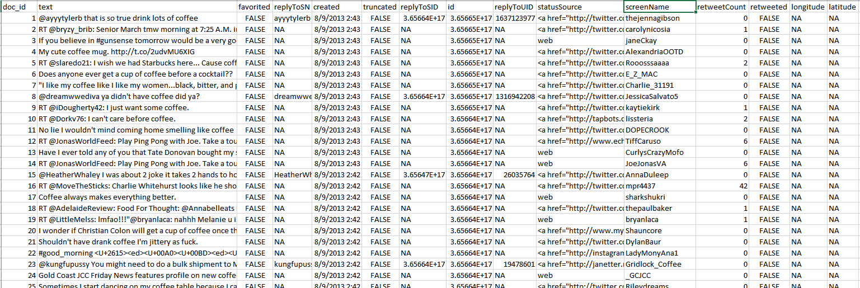
Meta Example
'$doc_id'
'$text'
META: $favorited, $created …
ID is for organization
Text is the information we want to examine
Meta adds context to our observations.

Slide 30
Nuances & Inputs for Setting Up a TM Project
“custom.stopwords” combines vectors of words to remove from the corpus
#Create custom stop words
customStopwords <- c(stopwords('english'), 'lol', 'smh')
Add channel specific stop words.
E.g. Twitter abbreviations
Retaining Meta Data Information
# Data
text<-read.csv('coffee.csv', header=TRUE)
# As of tm version 0.7-3 tabular was deprecated
names(text)[1]<-'doc_id' #first 2 columns must be 'doc_id' & 'text'
txtCorpus <- VCorpus(DataframeSource(text))
txtCorpus<-cleanCorpus(txtCorpus)

Slide 31
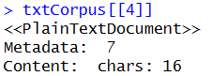
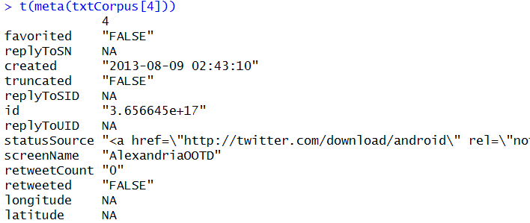
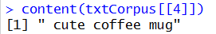
How do you retain meta information?
What is Meta?
What is content?
Meta information is data associated with the data you are analyzing. These can add context and allow you to partition data in insightful ways.
Timestamp (pre 9/11 Vs post 9/11)
Language (American Vs King’s English)
Author (Trump Vs Clinton)
Channel (Twitter Vs Legal Documents)
Content is simply the text (strings) you are analyzing. These data points represent the information of interest you are looking to gain insights from.
Retaining/Extracting Meta
Examining Content
SINGLE BRACKET
DOUBLE BRACKET
During an analysis it may be helpful to examine both meta & content information.

Slide 32
For Bag of Words, how is data organized?
Term Document Matrix
Document Term Matrix
 | Tweet1 | Tweet2 | Tweet3 | Tweet4 | … | Tweet_n
Term1 | 0 | 0 | 0 | 0 | 0 | 0
Term2 | 1 | 1 | 0 | 0 | 0 | 0
Term3 | 1 | 0 | 0 | 2 | 0 | 0
… | 0 | 0 | 3 | 0 | 1 | 1
Term_n | 0 | 0 | 0 | 1 | 1 | 0
 | Term1 | Term2 | Term3 | … | Term_n
Tweet1 | 0 | 1 | 1 | 0 | 0
Tweet2 | 0 | 1 | 0 | 0 | 0
Tweet3 | 0 | 0 | 0 | 3 | 0
… | 0 | 0 | 0 | 1 | 1
Tweet_n | 0 | 0 | 0 | 1 | 0
Code to Create the DTM/TDM and change to a matrix
Why are DTM & TDM Sparse? What do they represent?
txtDtm<-DocumentTermMatrix(txtCorpus)
txtTdm<-TermDocumentMatrix(txtCorpus)
txtDtmM<-as.matrix(txtDtm)
txtTdmM<-as.matrix(txtTdm)
??
The matrices are sparse (many 0’s) so additional steps may be needed to extract information.

Slide 33
Open 2_Cleaning_and_Frequency_Count_revised.R

Slide 34
Agenda
Start | End | Item
 |  | What is Text Mining (TM)?
 |  | Keyword Scanning
 |  | Preparation DTM/TDM
 |  | Associations & Dendrograms (Clustering)
 |  | Simple Wordcloud
 |  | Comparison Wordcloud
 |  | Polarity/Sentiment
Goals:
Learn the basics of text mining
Apply methods to real ( & messy) data

Slide 35
Once cleaned, let’s get word frequencies.
beerFreq<-rowSums(beerTDMm)
beerFreq<-data.frame(word=names(beerFreq),frequency=beerFreq)
Term Document Matrix
Word Frequency Matrix
 | Tweet1 | Tweet2 | Tweet3 | Tweet4 | … | Tweet_n
Term1 | 0 | 0 | 0 | 0 | 0 | 0
Term2 | 1 | 1 | 0 | 0 | 0 | 0
Term3 | 1 | 0 | 0 | 2 | 0 | 0
… | 0 | 0 | 3 | 0 | 1 | 1
Term_n | 0 | 0 | 0 | 1 | 1 | 0
word | freq
Term1 | 0
Term2 | 2
Term3 | 3
… | 5
Term_n | 2

Slide 36
What about a DTM?
beerFreq<-???????(beerDTMm)
beerFreq<-data.frame(word=names(beerFreq),frequency=beerFreq)
Document Term Matrix
Word Frequency Matrix
 | Term1 | Term2 | Term3 | … | Term_n
Tweet1 | 0 | 1 | 1 | 0 | 0
Tweet2 | 0 | 1 | 0 | 0 | 0
Tweet3 | 0 | 0 | 0 | 3 | 0
… | 0 | 0 | 0 | 1 | 1
Tweet_n | 0 | 0 | 0 | 1 | 0
word | freq
Term1 | 0
Term2 | 2
Term3 | 3
… | 5
Term_n | 2
Can anyone think of how you could get a DTM to be a WFM?

Slide 37
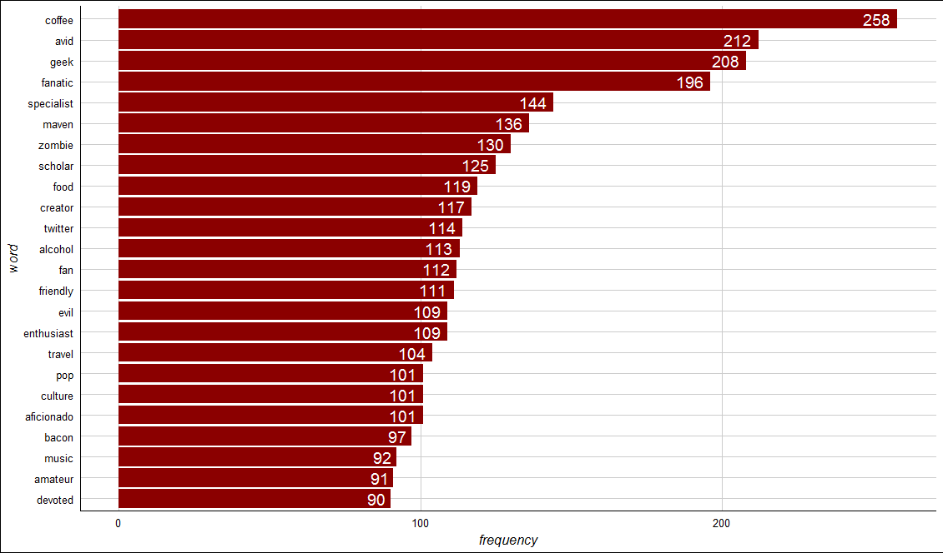
Open 3_Dendrogram.R to visualize the WFM

Slide 38
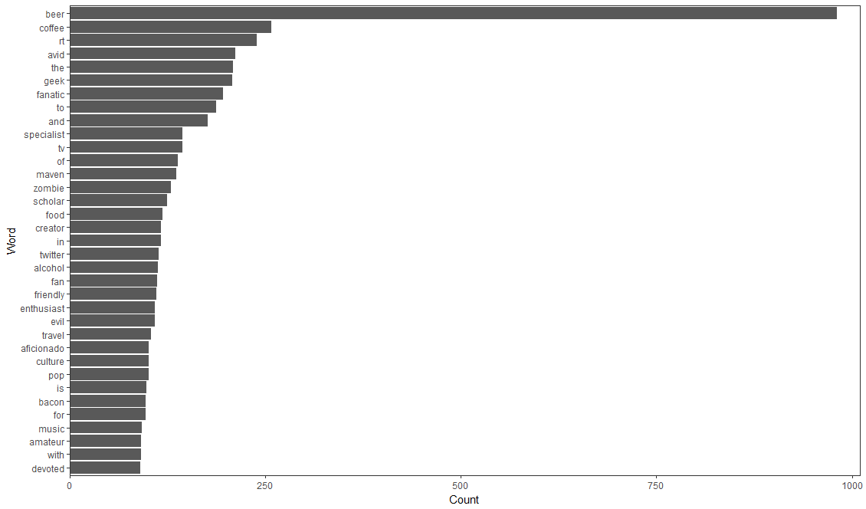

Open 3_Dendrogram.R to visualize the WFM

Slide 39
Zombies!! Word Association
# Inspect word associations
associations<-findAssocs(beerTDM, 'zombie', 0.30)
# Make a dot plot
zombieDF<-data.frame(terms=names(associations[[1]]),
value=unlist(associations))
zombieDF$terms<-factor(zombieDF$terms, levels=zombieDF$terms)
ggplot(zombieDF, aes(y=terms)) +
geom_point(aes(x=value), data=zombieDF, col='#c00c00') +
theme_gdocs() +
geom_text(aes(x=value,label=value), colour="red",hjust=-.25, size=3)
Adjust 0.30 to get the terms that are associated .30 or more with the ‘zombie’ term.
Treating the terms as factors lets ggplot2 sort them for a cleaner look.
Word Association is similar to correlation. When word A appears, how often does word B? Unlike correlation, terms can only be positively associated. This is because there are so many terms that everything would be “negatively correlated (associated).

Slide 40
Back to 3_Dendrogram_revised.R

Slide 41
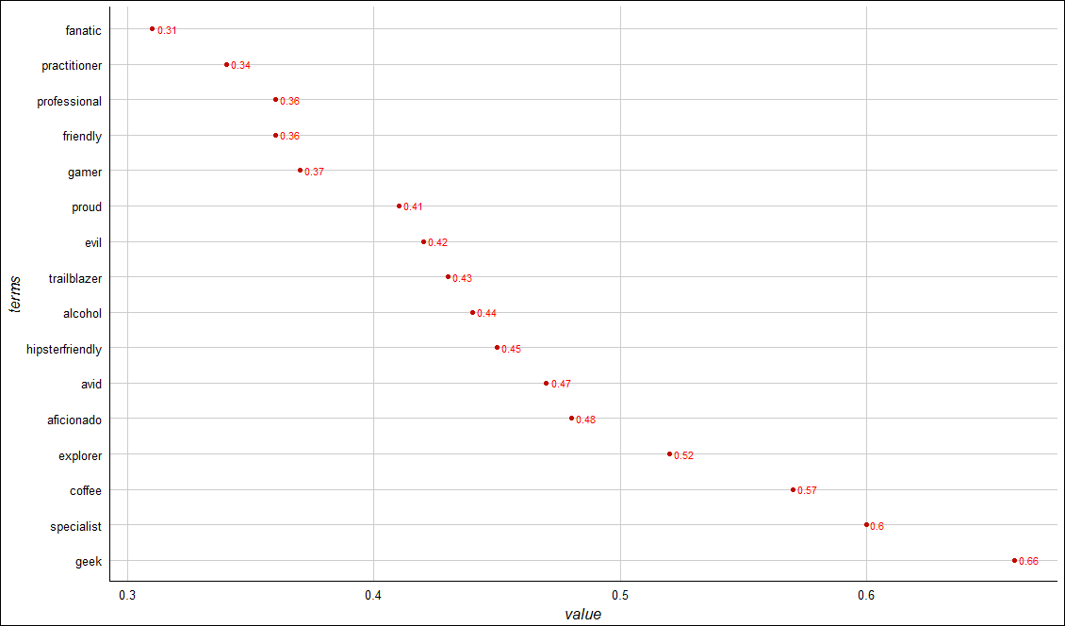
Zombies!! Word Association
Geek has the highest word association with “zombie”
Alcohol geek. Avid tv buff. Friendly beer aficionado. Coffee guru. Zombie junkie.

Slide 42
Dendrograms
Real Rainfall Data
Rainfall Data as a Dendrogram
City | Annual Rainfall
Portland | 43.5
Boston | 43.8
New Orleans | 62.7
63
44
Keep in Mind a Dendrogram
New Orleans
Reduces information much like average is a reduction of many observations’ values
Word clusters emerge often showing related terms
Term frequency is used to construct the word cluster. Put another way, term A & term B have similar freq. distances & are considered a cluster
Boston
Portland
Boston & Portland are a cluster at height 44, losing precision to create the cluster.
Visualizes hierarchical data. For text, the frequency distances are calculated to create the hc object.

Slide 43
Back to 3_Dendrogram_revised.R

Slide 44
Agenda
Start | End | Item
 |  | What is Text Mining (TM)?
 |  | Keyword Scanning
 |  | Preparation DTM/TDM
 |  | Associations & Dendrograms (Clustering)
 |  | Simple Wordcloud
 |  | Comparison Wordcloud
 |  | Polarity/Sentiment
Goals:
Learn the basics of text mining
Apply methods to real ( & messy) data

Slide 45
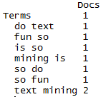
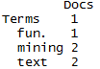
Tokenization
#bigram token maker
bigramTokens <-function(x)
unlist(lapply(NLP::ngrams(words(x), 2), paste, collapse = " "), use.names = FALSE)
wineTDM<-TermDocumentMatrix(txtCorpus, control=list(tokenize=bigramTokens))
Text Mining is so fun. So do Text Mining!
Unigram
Bigram
*with common stopwords
New Text Mining Concept
Tokenization- So far we have created single word n-grams. We can create multi word “tokens” like bigrams, or trigrams with this line function. It is applied when making the term document matrix.

Slide 46
What is a word cloud?
To make a word cloud we follow the previous steps and create a data frame with the word and the frequency.
# Get Row Sums
wineTDMv <- sort(rowSums(wineTDMm),decreasing=TRUE)
wineDF <- data.frame(word = names(wineTDMv),freq=wineTDMv)
Term Document Matrix
 | Tweet1 | Tweet2 | Tweet3 | Tweet4 | … | Tweet_n
Term1 | 0 | 0 | 0 | 0 | 0 | 0
Term2 | 1 | 1 | 0 | 0 | 0 | 0
Term3 | 1 | 0 | 0 | 2 | 0 | 0
… | 0 | 0 | 3 | 0 | 1 | 1
Term_n | 0 | 0 | 0 | 1 | 1 | 0
word | freq
Term1 | 0
Term2 | 2
Term3 | 3
… | 5
Term_n | 2
Setup
A word cloud is a visualization of term (token) frequencies.

Slide 47
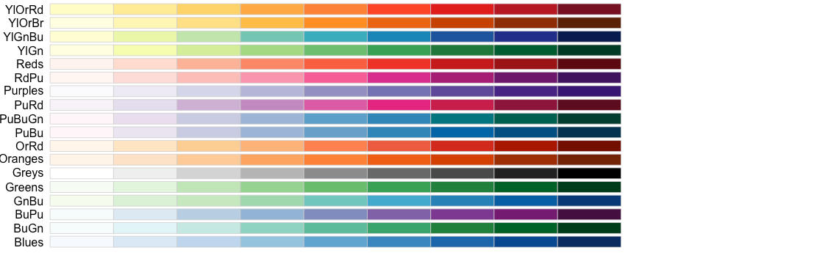
Selecting a color for your word cloud.
# Review all Pallettes
display.brewer.all()
# Choose a color & drop light ones
pal <- brewer.pal(8, "Blues")
pal <- pal[-(1:2)]

Slide 48
Let’s Practice!
4_Simple_Wordcloud_revised.R

Slide 49
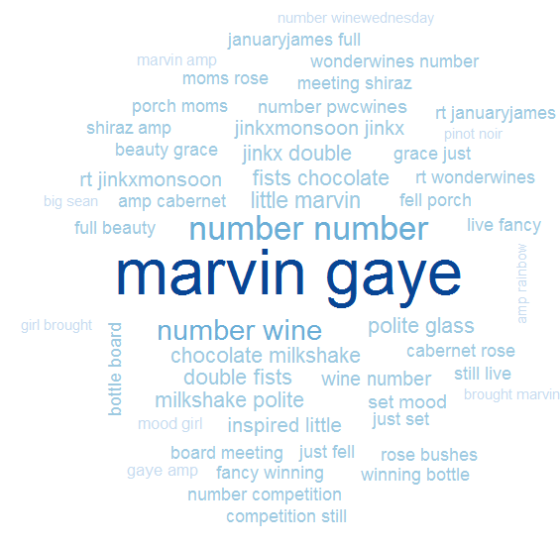
4_Simple_Wordcloud_revised.R
Bigram Tokenization has captured “marvin gaye”
A word cloud is a frequency visualization. The larger the term (or bigram here) the more frequent the term.
You may get warnings if certain tokens are to large to be plotted in the graphics device.
In cleanCopurs() the function … changes numeric with the generic string “number” so be careful with your preprocessing steps!

Slide 50
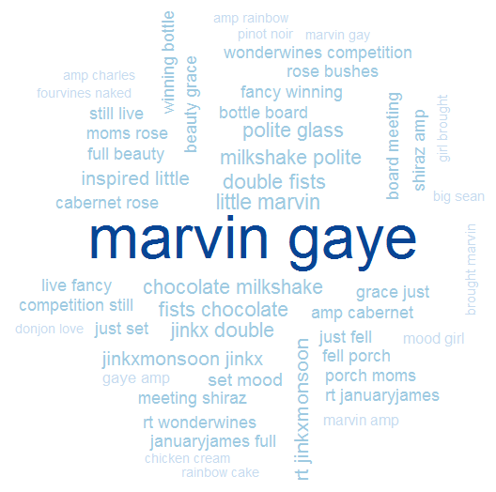
4_Simple_Wordcloud.R
In cleanCorpus() the function replace_symbol() changes numeric with the generic string “number” so be careful with your preprocessing steps!

Slide 51
Agenda
Start | End | Item
 |  | What is Text Mining (TM)?
 |  | Keyword Scanning
 |  | Preparation DTM/TDM
 |  | Associations & Dendrograms (Clustering)
 |  | Simple Wordcloud
 |  | Comparison Wordcloud
 |  | Polarity/Sentiment
Goals:
Learn the basics of text mining
Apply methods to real ( & messy) data

Slide 52
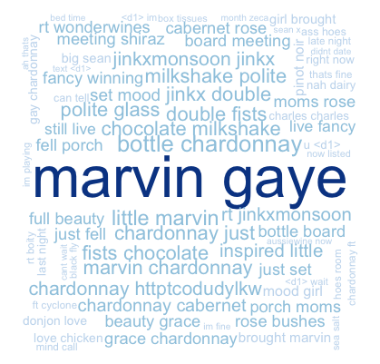
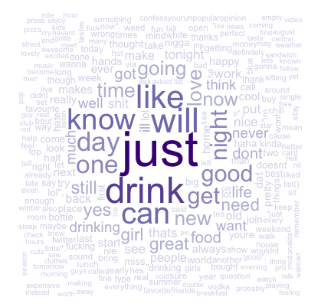
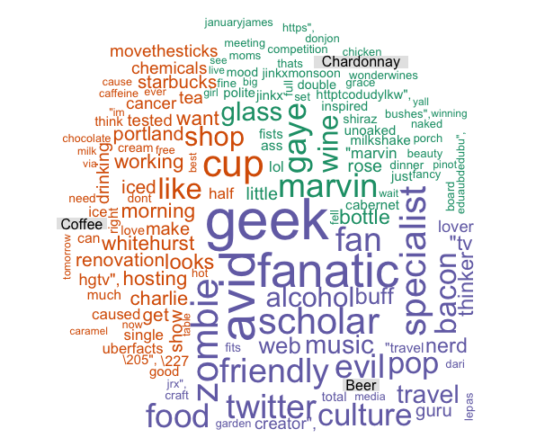
Types of Wordclouds
Multiple Corpora
Single Corpus
wordcloud( )
comparison.cloud( )
commonality.cloud( )
comparison.cloud( )
comparison.cloud( )

Slide 53
Dealing with many text files
The challenge is working with multiple corpora efficiently. Many ways to do it…
# Read in multiple files as individuals
txtFiles<-c('chardonnay.csv','coffee.csv','beer.csv') #use list.files() for a lot
for (i in 1:length(txtFiles)){
assign(txtFiles[i], read.csv(txtFiles[i]))
cat(paste('read completed:',txtFiles[i],'\n'))
}
# Read them into a single list with individual elements
all<-pblapply(txtFiles,read.csv)
Two example ways to import csv files:
Each file is read in and an object created for each.
A list called “all” is created. Each list element represents a single document. Using data.table::rbindlist() one can create a single document from all files in the folder.

Slide 54
Lets make some improved word clouds
Open 5_Other_Wordclouds_revised.R

Slide 55
Agenda
Start | End | Item
 |  | What is Text Mining (TM)?
 |  | Keyword Scanning
 |  | Preparation DTM/TDM
 |  | Associations & Dendrograms (Clustering)
 |  | Simple Wordcloud
 |  | Comparison Wordcloud
 |  | Polarity/Sentiment
Goals:
Learn the basics of text mining
Apply methods to real ( & messy) data

Slide 56
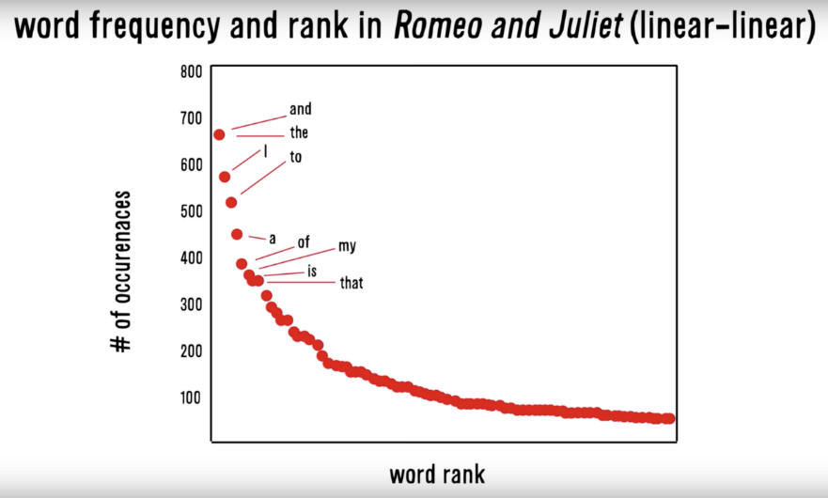
Zipf’s Law: Our words are less diverse than we think
Two very different contexts, channel, & messengers yet very similar pattern.
RT
I
Many words in natural language but also a steep decline in actual usage. Follows a predictable pattern.

Slide 57
Simple Sentiment Polarity
Scoring
Zipf’s Law
Surprise is a sentiment.
Hit by a bus! – Negative Polarity
Won the lottery!- Positive Polarity
Many words in natural language but there is steep decline in everyday usage. Follows a predictable pattern.
I loathe BestBuy Service -1
I love BestBuy Service. They are the best. +2
I like shopping at BestBuy but hate traffic. 0
R’s QDAP polarity function scans for positive words, and negative words as defined by MQPA Academic Lexicon research. It adds positive words and subtracts negative ones along with valence shifters. The final score represents the polarity of the social interaction.

Slide 58
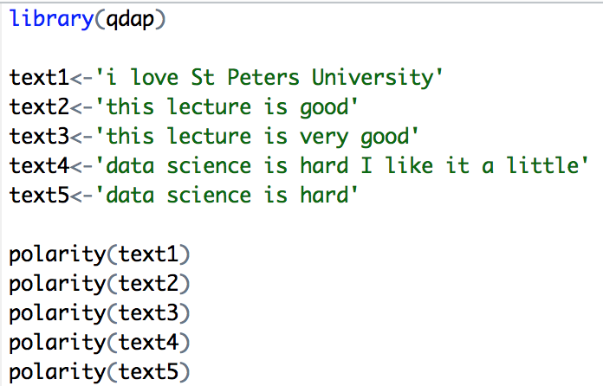
Simple Sentiment Polarity
Scoring
Text 1: “love” was identified as positive. The text has 5 words and so 1/sqrt(5) = .447
Text 2: “good” was identified positively. So 1/sqrt(4)=.5
Text 3: “good” was found along with the amplifier “very”. So (.8+1)/sqrt(5)=.805
Text 4: hard and like cancel each other out so the polarity is zero. 1-1/sqrt(9)=0
Text 5: “hard” is -1/sqrt(4)=-.50
First it looks for the polarized word. Then identifies valence shifters (default 4 words before and two words after) Amplifiers are assigned +.8 and de-amplifiers weight is constrained to -1. Lastly the sum is divided by the square root of the total number of words in the passage.

Slide 59
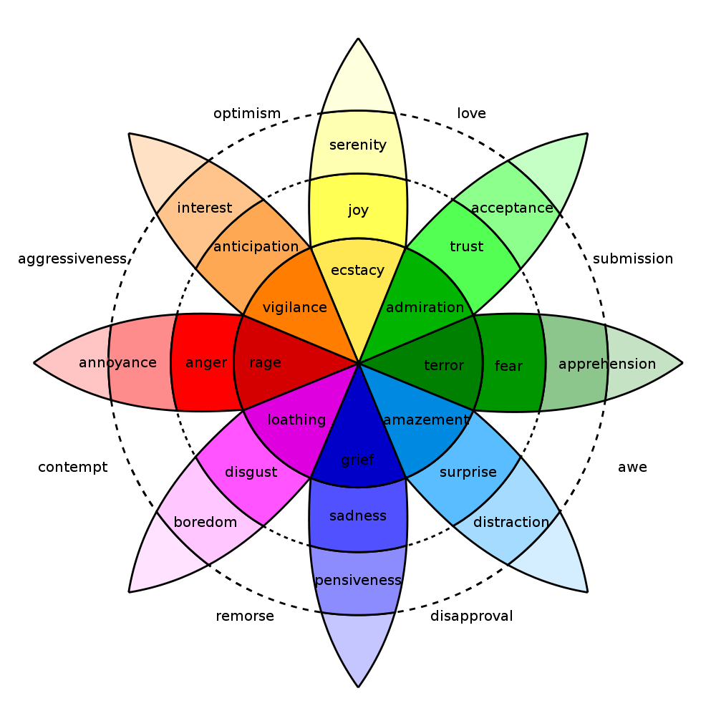
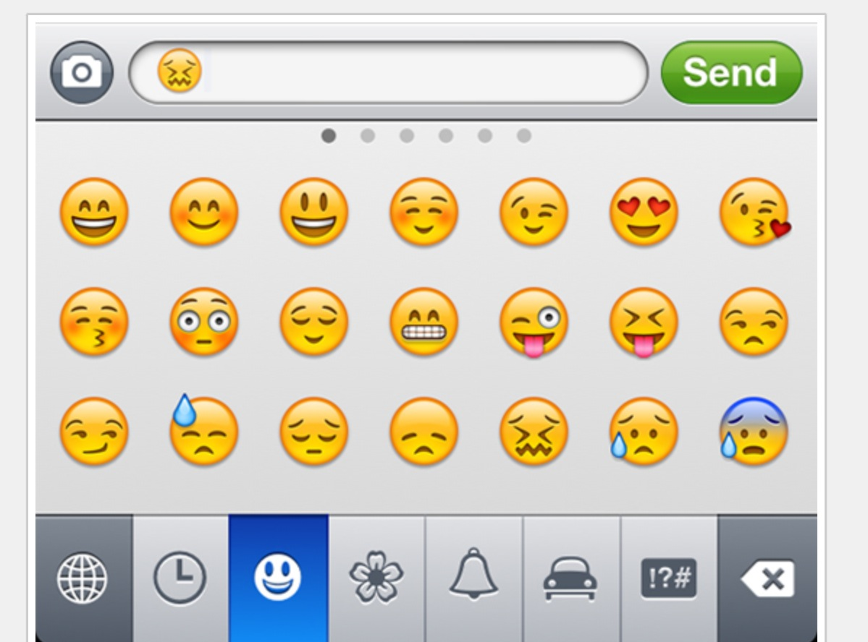
In reality sentiment is more complex.
Many Many Emoji
Plutchik’s Wheel

Slide 60
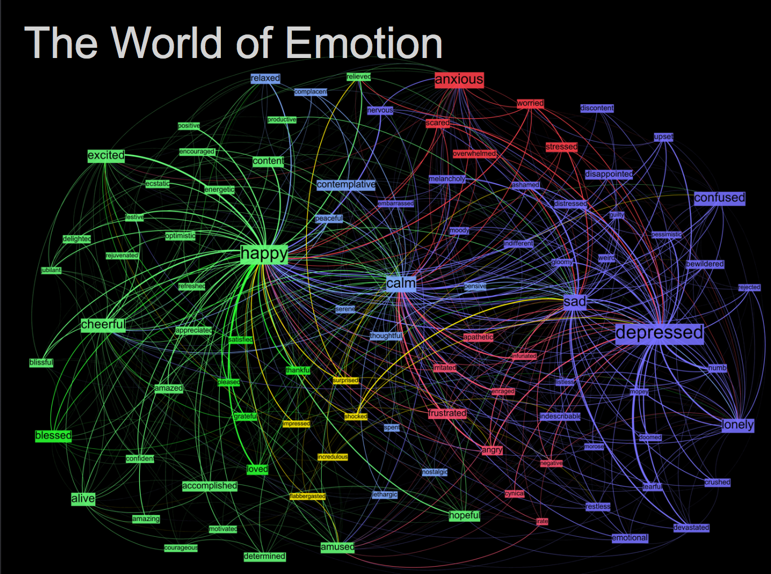
Kanjoya’s Experience Corpus

Slide 61
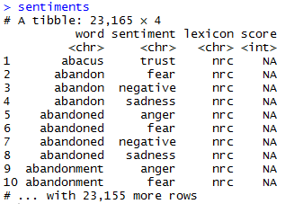
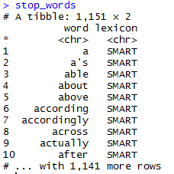
Sentiment the Tidy Way uses joins with existing lexicons
##Tidy Sentiment Analysis
data(sentiments)
sentiments
#Stopwords
data(stop_words)
stop_words
#Add stopwords
custom.stopwords<-data.frame(word=c('amp','beer'),
lexicon='custom')
stop_words<-rbind(stop_words,custom.stopwords)

Slide 62
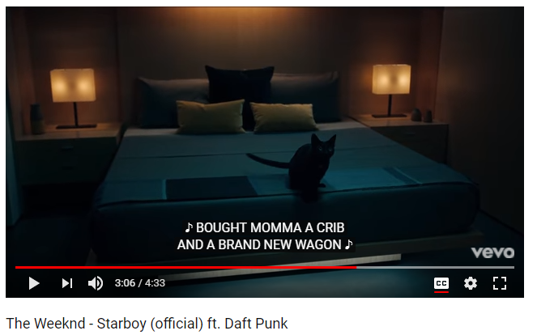
In this exercise we will examine song lyrics

Slide 63
Tidy data uses %>% to forward objects
Tidytext is part of the tidy universe including ggplot and dplyr. Code is structured so it is more easily read using the %>%. The data format is a tibble and is in “tidy” format (long form).
mtcars %>% group_by(cyl) %>% mutate(rank = min_rank(desc(mpg)))
This reads as “Using the mtcars object then group by the cyl vector then mutate a new variable called rank.

Slide 64
Tidy can seem complicated but not impossible.
The pipe operator
%>%
Forwards an object so the code is easy to understand & concise.
all.tidy <- all.tidy %>%
anti_join(stop_words)
Song text
Stop words
anti_join()
all.sentiment <- all.tidy %>%
inner_join(nrc.lexicon) %>%
count(tweet,sentiment) %>%
spread(tweet, n, fill = 0)
Sentiment
words
Song text
inner_join()

Slide 65
Starting with a DTM, its straightforward
# DTM
txtDTM<-DocumentTermMatrix(txtCorpus)
txtDTM
dim(txtDTM)
# Tidy
tidyCorp<-tidy(txtDTM)
tidyCorp
dim(tidyCorp)
# Get bing lexicon
# "afinn", "bing", "nrc", "loughran"
bing<-get_sentiments(lexicon = c("bing"))
head(bing)
# Perform Inner Join
bingSent<-inner_join(tidyCorp,bing, by=c('term'='word'))
DTM is from the “tm” library
Easy way to make it into a tibble.
Weeknd Lyrics
Bing Lexicon

Slide 66
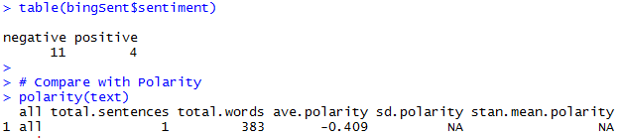
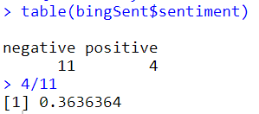
Similar polarity scores in both methods
Weeknd Lyrics
Bing Lexicon
The polarity function from qdap and the inner_join show similar negative results.

Slide 67
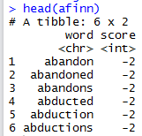
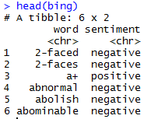
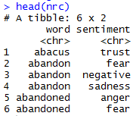
TidyText has other sentiment lexicons
Each can be used in an inner join to get different ways of assessing sentiment.
AFINN- Dutch researcher
Words scored -5 to 5
Bing- U of I-Chi Researcher
Words scored Pos/Neg
NRC – mTurk
Words classified into 8 primary & pos/neg
Weeknd Lyrics
Sentiment Lexicon

Slide 68
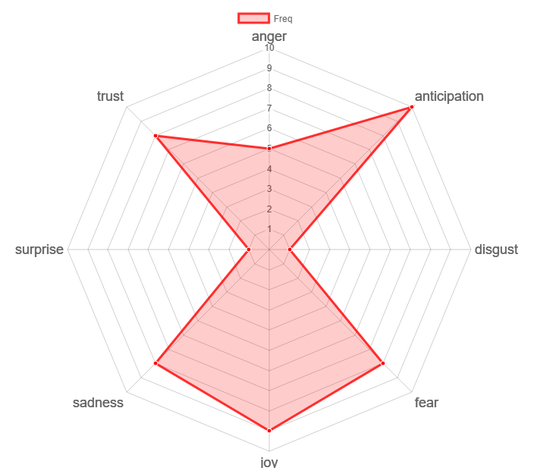
Remember Plutchik’s Wheel of emotion? Let’s mimic it!
The script drops positive & negative to focus on the explicit emotions.

Slide 69
Let’s practice sentiment analysis
Open 6_TidyText_Sentiment_revised.R
Open 6_TidyText_Sentiment_revised.R

